Slide 1
Solve problems
like Rémi BRISSIAUD

Slide 2
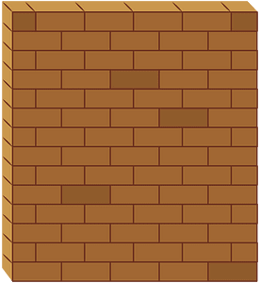
How many bottles are on the wall ?

Slide 3
How many bottles are on the wall ? What happened ?

Slide 4
How many bottles are on the wall ? What happened ?

Slide 5
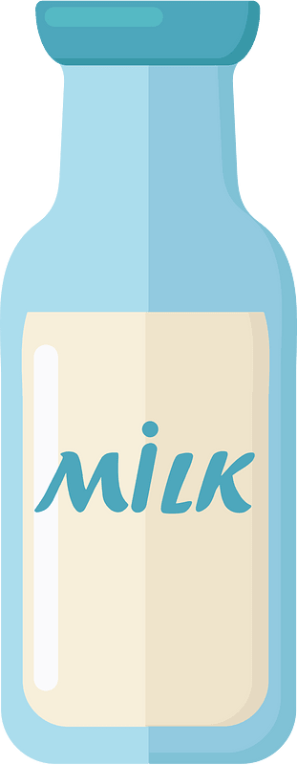
How many bottles are on the wall ?

Slide 6
How many bottles are on the wall ? What happened ?

Slide 7
How many bottles are on the wall ? What happened ?

Slide 8
How many bottles are on the wall?

Slide 9
How many bottles are on the wall? What happened?

Slide 10
3 fell down.

